Slide 1
Visualizing Option Strategies with R Shiny
Ward Greunke
January 22nd, 2019

Slide 2
Poll
Shiny Programmers?
Options Traders?

Slide 3
Introduction
Bio-
BS Mechanical Engineering
MBA (Financial Engineering, Behavioral Finance)
Experience in Product Management, Marketing, Engineering, Operations
Disclaimer
Not financial advisor
Own positions in the securities discussed
Options trading can result in losses beyond initial capital invested
Data is not accurate and equations have not been validated

Slide 4



Why use Options?
What if Tesla doesn’t meet its production target? (Puts)
Believe Qualcomm will win lawsuit against Apple (Calls)
Lose $2.65 billion
(Currency Options)
Notes:
Aracruz – Brazilian pulp manufacturer bought foreign exchange options betting that the real would continue to increase against the dollar. Instead lost 24% against the dollar.

Slide 5
What are Options?
The right to buy / sell an underlying asset at a specific price in the future but not the obligation.
Futures commit you to purchasing the asset.

Slide 6
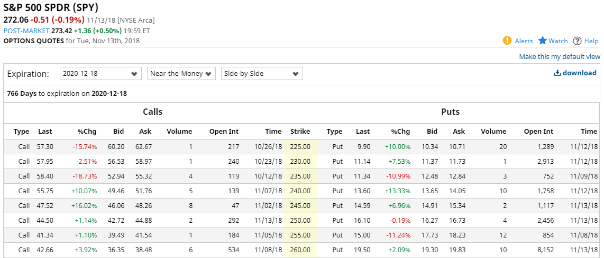
Project Background
Options are complicated:
Underlying price
Strike Price
Current Price
In / Out of Money
Call / Put, Short / Long
Time to Maturity
Combine into strategy
R Shiny
Web based graphical interface
Separation of model and view
Instant hosting – shinyapps.io
R graphing and tabular data

Slide 7
Notation / Equations
Long Call Payoff*
S: Current price of the asset.
T: maturity date of options
St: asset price at date T
K: strike price of option.
C: Current Call Price
P: Current put price
Strike price vs asst price | Payoff
St ≥ K | St – K
St < K | 0
Long Put Payoff*
Strike price vs asst price | Payoff
St < K | K - St
St ≥ K | 0
*Source: Derivatives Principles and Practice, Rangarajan K. Sundaram and Sanjiv R. Das, Pg 159

Slide 8
Option Payoff (Call)
Gross Payoff
St: asset price at Expiration
K: strike price of option. = 100
C: Current Call Price = 10
Payoff depends on price at expiration.
Net Payoff
Payoff
Strike Price
Price at Expiration
100
10
Option Price
Out of the Money
In the Money

Slide 9
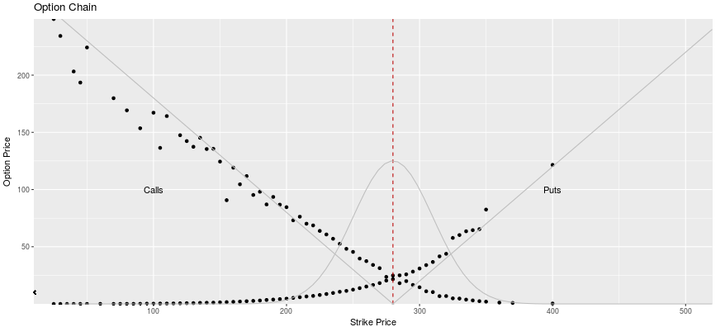
Option Chain
Current Price
Relationship between Puts / Calls, Current Price and Volatility

Slide 10
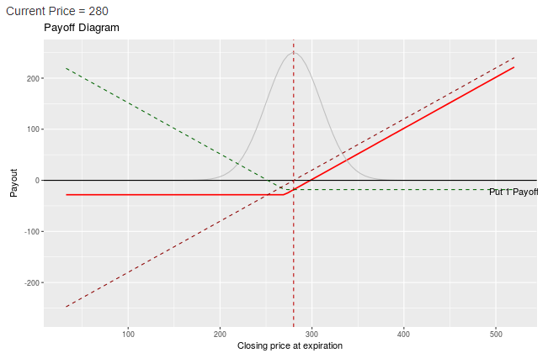
Protective Put
Insurance against a drop in price of stock that you already own.
Sacrifice some gains for protection from extreme losses.
Long Stock, Long Put

Slide 11
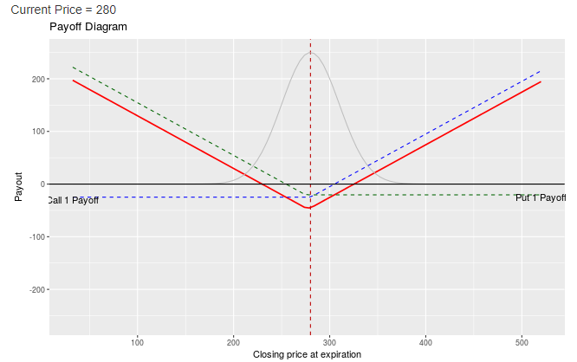
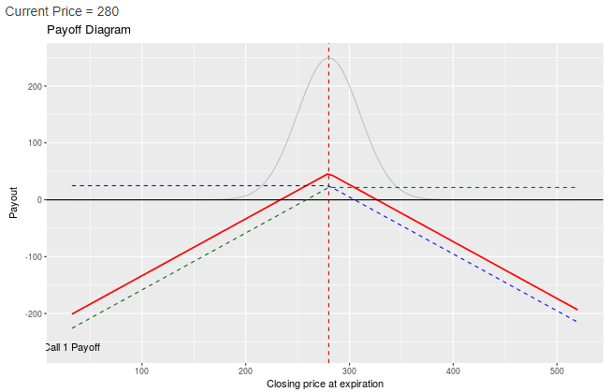
Option Strategies
Long Straddle
Anticipate big change either direction
Buy 1 Call, 1 Put
Short Straddle
Anticipate stable price
Short 1 Call, Short 1 Put

Slide 12
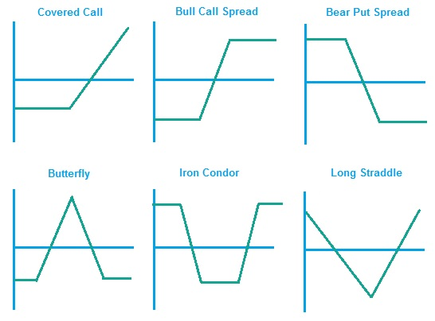
Additional Strategies

Slide 13
Demo https://optionvis.shinyapps.io/optionrepo/

Slide 14
Shortcut 1: Static UI Parameters
strike.price<-c(25,400)
…
sliderInput("si.call.1","Strike Price",min=-min(strike.price),max=max(strike.price),value=215)
#Load the S&P data from csv file
raw.chain=read.csv("sp5002019dec_2.csv")
call.df=subset(raw.chain,Option.Type=="Calls")
output$distPlot <- renderPlot({…
…
call.1.index<- call.df$Strike-input$si.call.1)
…
Slider Output
Graph Updates
ui.R
server.R
Need to update the slider bar range from the server logic.

Slide 15
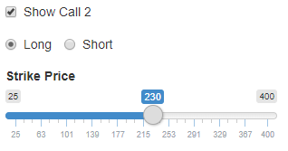
Shortcut 2: Shiny Slider Input
Started with drop down but not intuitive.
Used slider on vector that is not evenly spaced.
ui.R
sliderInput("si.call.2","Strike Price", min=min(strike.price),max=max(strike.price),value=215)
server.R
call.2.index=which.min(abs(call.df$Strike-input$si.call.2))
call.2.price=call.df$Last_Price[call.2.index]

Slide 16
Building the Payoff Vector
Server.R
output$distPlot <- renderPlot({…
show.call.1<-input$show_call_1
call.1.long.short=<-input$rb.call.1.long.short
if(call.1.long.short=="Long")
{ c.payoff<-LongCallPayoff(-call.1.price,call.1.strike.price,closing.price) }
else{c.payoff<-ShortCallPayoff(call.1.price,call.1.strike.price,closing.price)}
#Start with an empty horizontal line then add the payoffs if the box is checked
total.payoff<-rep(0,length(closing.price))
if(show.call.1){total.payoff=total.payoff+call.1.payoff}
if(show.call.2){total.payoff=total.payoff+call.2.payoff}

Slide 17
Questions?

Slide 18
Thank You

Slide 19
Link to SHIny App:
https://optionvis.shinyapps.io/optionrepo/

